Slide 1

Meme-Machine
Brought to you by: char broiled;
Group Members:
Matthew Jagielski, Jacob Bieker, Ian Garrett, Theodore LaGrow

Slide 2
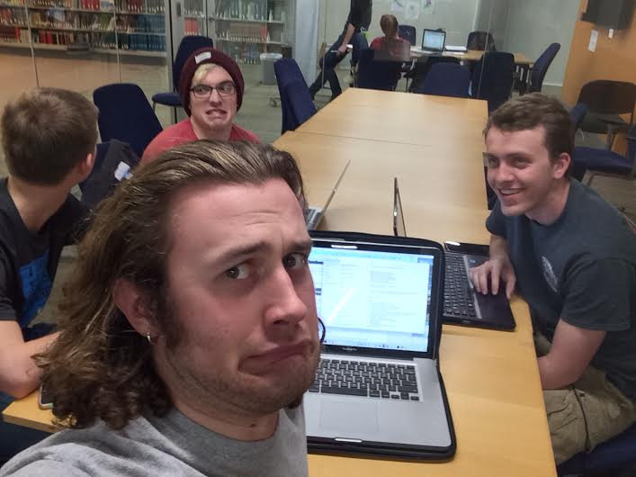
Overview of Project
Code so hard
Server/Client Chat
Encryption
Meme-afy
Qt Gui
Memes wanna
find me

Slide 3
Overview of Project
Code so hard
Server/Client Chat
Encryption
Meme-afy
Qt Gui
Memes wanna
find me

Slide 4
Overview of Project
Code so hard
Server/Client Chat
Encryption
Meme-afy
Qt Gui
Memes wanna
find me

Slide 5
Overview of Project
Code so hard
Server/Client Chat
Encryption
Meme-afy
Qt Gui
Memes wanna
find me

Slide 6
Overview of Project
Code so hard
Server/Client Chat
Encryption
Meme-afy
Qt Gui
Memes wanna
find me

Slide 7
Overview of Project
Code so hard
Server/Client Chat
Encryption
Meme-afy
Qt Gui
Memes wanna
find me

Slide 8
Overview of Project
Code so hard
Server/Client Chat
Encryption
Meme-afy
Qt Gui
Memes wanna
find me

Slide 9
Overview of Project
Code so hard
Server/Client Chat
Encryption
Meme-afy
Qt Gui
Memes wanna
find me

Slide 10
Demonstration
(Hopefully the code works!)

Slide 11
Encryption

Slide 12
Chat Server/Client
Developed a client and server accepting single instance call
Discovered Qt supported multithreaded chat client
Build in with the Qt front end

Slide 13
Meme Creator

Slide 14
Frontend: Qt, GUI

Slide 15
Risk Management

Slide 16
Questions?

Slide 17
Thank you!

